Slide 1

Solution Sales Training
NDI & NHD
Powerful · Reliable · Simple

Slide 2
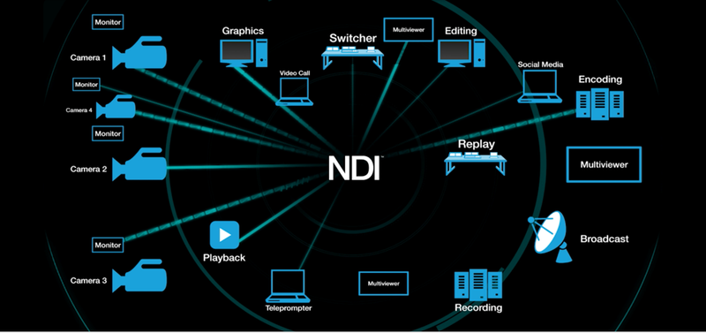
NDI® & NDI® 6 – Why It’s Used in Modern AV Workflows
What is NDI® 6?
Latest generation of NDI (Network Device Interface) developed by Vizrt
Transports high-quality video, audio, and metadata over standard IP networks
Why NDI is Utilized:
Leverages Standard IT Infrastructure
Uses existing Ethernet networks instead of dedicated video cabling
Reduces installation cost and deployment complexity
Low Latency, High Quality Video
Near real-time performance suitable for live production and conferencing
Supports HD and 4K video with synchronized audio and metadata
Simple Deployment & Scalability
Automatic device discovery and routing
Easily add cameras, PCs, or displays without redesigning systems
Flexible Software-Driven Workflows
Native integration with Teams, OBS, vMix, Zoom, and broadcast tools
Many workflows handled via software instead of dedicated hardware
Bi-Directional & Distributed Operation
Send and receive video/audio on the same network
Enables remote production, hybrid environments, and centralized control
Future-Ready AV Architecture
Any source can be viewed, recorded, streamed, or displayed anywhere on the network
Powerful · Reliable · Simple

Slide 3
Opportunity
Rapid Ecosystem Growth: With thousands of NDI-enabled products, the technology is moving beyond traditional broadcasting into corporate AV, education, and healthcare.
Lowered Production Barriers: NDI allows for multi-camera, high-quality, low-latency productions using standard Gigabit network infrastructure. This reduces hardware costs and simplifies setups for live streaming virtual meetings, and hybrid events.
Integration with Emerging Tech: The industry is actively integrating NDI with AI for automatic camera tracking and advanced 3D content creation using Unreal Engine.
Strategic Partnerships: Major industry players like Sony, Panasonic, and Vizrt are adopting the standard, signaling long-term viability and stability for investments.
NDI is not just a video transport protocol.
It is a market expansion technology that:
Lowers deployment cost
Enables software-defined AV
Expands AV into IT workflows
Increases system scalability and lifetime value
Powerful · Reliable · Simple

Slide 4
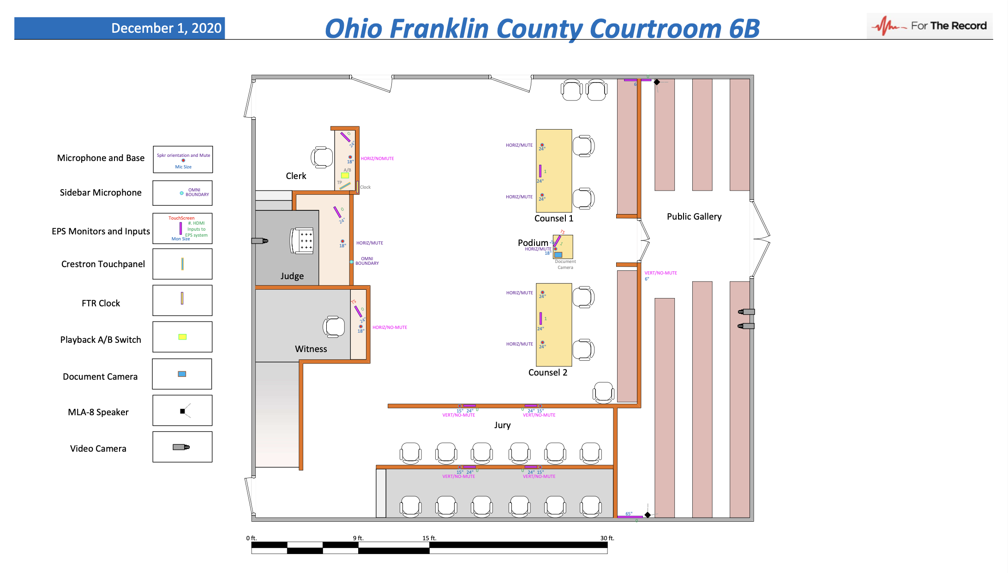
Digital Court/Government AV
Powerful · Reliable · Simple

Slide 5
Design Considerations
Organizations face several key challenges:
Infrastructure Limitations
Conventional AV Systems rely on specialized video cabling increasing installation costs and reducing flexibility
Scalability constraints:
Adding cameras, collaboration systems, or monitoring endpoints require significant upgrades
Operational Inefficiency:
Separate systems for production, conferencing, streaming, and monitoring create complex system paths
Powerful · Reliable · Simple

Slide 6
Bridging Broadcast (NDI) and ProAV (AVoIP)
Two IP Video Worlds — Different Purposes
🎥 Broadcast / Production (NDI)
Focused on Content Creation
Cameras, software, and streaming workflows
Used with OBS, vMix, Teams, lecture capture
Flexible source discovery & routing
Ideal for recording and live production
➡ Answers: “How do we create video?”
🖥️ ProAV Distribution (NetworkHD)
Focused on Reliable Delivery
Facility-wide video routing
Videowalls, Multiview, room displays
Integrated with control systems
➡ Answers: “How do we deliver video everywhere?”
Powerful · Reliable · Simple

Slide 7
Codec Comparison
Feature | NDI | H.264 | H.265 (HEVC) | JPEG2000
Primary Use Case | Live production & software workflows | Streaming & conferencing | Efficient distribution | Broadcast & mission-critical AV
Compression Type | Intra-frame (visually lossless) | Long GOP | Long GOP (advanced) | Intra-frame
Typical Latency | ~1–2 frames | 100–500 ms | 150–800 ms | ~1 frame
Bandwidth (1080p60) | ~100–150 Mbps | 4–8 Mbps | 2–6 Mbps | 150–300 Mbps
Bandwidth (4K60) | ~250–400 Mbps | 15–25 Mbps | 10–20 Mbps | 600 Mbps–1.2 Gbps
Network Requirement | 1Gb managed network | Any IP network | Any IP network | 1–10Gb network
Video Quality | Visually lossless | Lossy | Higher efficiency lossy | Visually lossless
Frame Accuracy | Very good | Moderate | Moderate | Excellent
Discovery / Routing | Auto discovery | Manual | Manual | Controlled routing
Scalability | Very high | Very high | Very high | Medium
Typical Latency Sensitivity Use | Live switching | Streaming | Remote viewing | Broadcast production
Best Strength | Flexibility & software integration | Low bandwidth | Maximum efficiency | Quality + reliability
Main Tradeoff | Higher bandwidth than H.265 | Higher latency | Higher latency | Higher cost/bandwidth
Powerful · Reliable · Simple

Slide 8
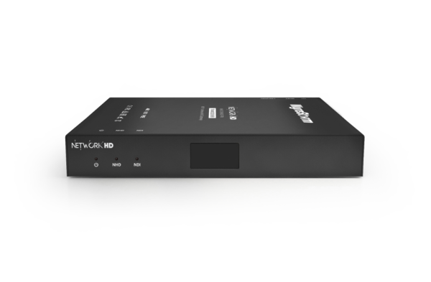
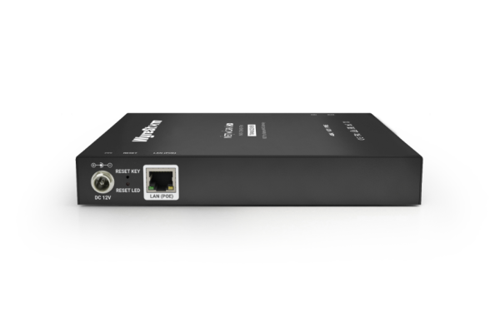
What is the NHD-128-NDI-TRX?
NHD-128-NDI-TRX
NDI ↔ NetworkHD Gateway
• Converts up to 8 NDI HX (NDI ® 6) streams into NetworkHD 100s (H.265) • Outputs 1 NetworkHD stream to NDI (Teams, OBS, vMix) • True bidirectional conversion in one device • Compact and PoE-powered for simple deployment • Reduces system complexity by replacing multiple converters • Cloud-enabled for remote monitoring and management • Ideal for courtrooms, lecture halls, and corporate AV
Powerful · Reliable · Simple

Slide 9
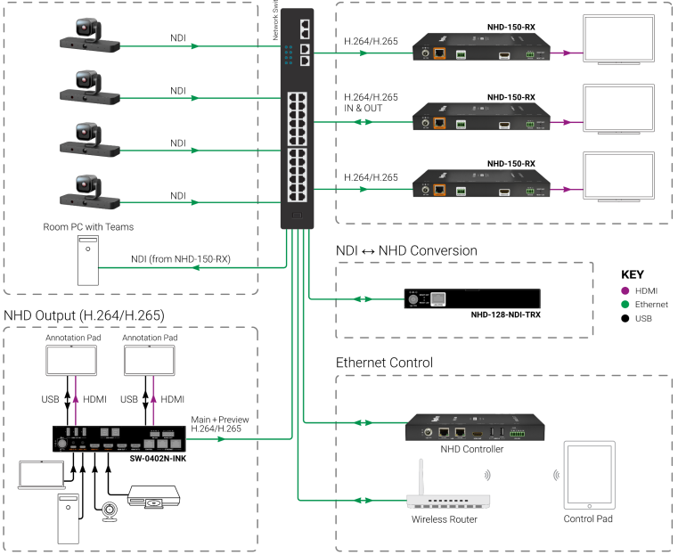
System Diagram
Powerful · Reliable · Simple

Slide 10
Comparison to Competition
Feature | WyreStorm | Uray | Kiloview | Magewell Encoder | Magewell Decoder | WyreStorm Advantage
Model | NHD-128-NDI-TRX | URayCoder | FMG-400 | Pro Convert NDI Encoder | Pro Convert Decoder (NDI + SRT) | —
Primary Function | Bi-directional NDI ⇄ AVoIP Gateway | Streaming Encoder | Encoding Platform | NDI Encoder | NDI Decoder | ✅ Only true NDI ↔ AVoIP bridge
Input | • 1× NHD input (up to 4K60) • 8× NDI inputs (up to 4K30) | H.264/H.265 IP stream input (4K) | H.264/H.265 encode 4K60 | HDMI/SDI input up to 4K60 | NDI input up to 4K60 | ✅ Multi-channel ingest vs single-purpose devices
Output | • 1× NHD → NDI • 8× NDI → NHD (4K30) | 4-ch H.264/H.265 → NDI HX | Transcoding platform | HDMI/SDI → NDI | NDI → HDMI/SDI/AIO | ✅ Simultaneous encode + decode
Conversion Type | Bidirectional conversion | Encode only | Transcode only | Encode only | Decode only | ✅ Replaces multiple boxes
PoE Powered | ✅ | ❌ | ❌ | ✅ | ✅ | ✅ Simplified installs
Audio Output | ✅ | ✅ | ✅ | ✅ | ✅ | —
Fanless Design | ✅ | ✅ | ❌ | ✅ | ✅ | ✅ Silent operation (courtrooms / education)
Ethernet | 1× GbE | 1× GbE | 1× GbE | 1× GbE | 1× GbE | —
Front Status Display | ✅ LED Screen | ❌ | ❌ | ❌ | ❌ | ✅ Easier deployment & troubleshooting
Channels per Device | Up to 8 streams | Limited | Single workflow focus | Single channel | Single channel | ✅ Higher density per device

Slide 11
Vertical 1 (Digital Court/Government AV)
Problem:
Cameras are often NDI
Displays are fed by AVoIP (NetworkHD)
Cameras are ingested into HDMI Encoders
Separate encoders/decoders increase device count and cost
How the NHD-128-NDI-TRX Helps:
Converts NDI camera feeds directly into NHD streams
Feed jury, gallery, judge displays over AVoIP
Eliminate standalone NDI/NHD encoders
Simplified Control and Management
Powerful · Reliable · Simple

Slide 12
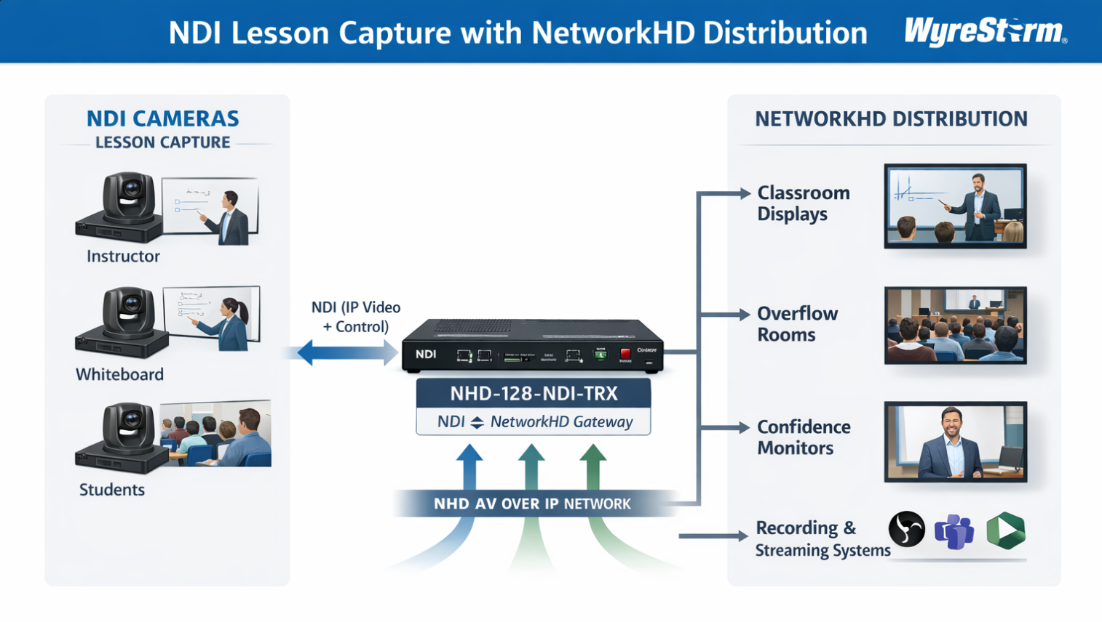

Vertical 2 (Education/Lecture Capture)
Problem:
Production team uses NDI cameras and production switchers
Need flexible routing between systems
How TRX Helps:
8 NDI channels ingest into AVoIP
1 NHD to NDI return feed for production
Clean integration between control room and distribution
Powerful · Reliable · Simple

Slide 13
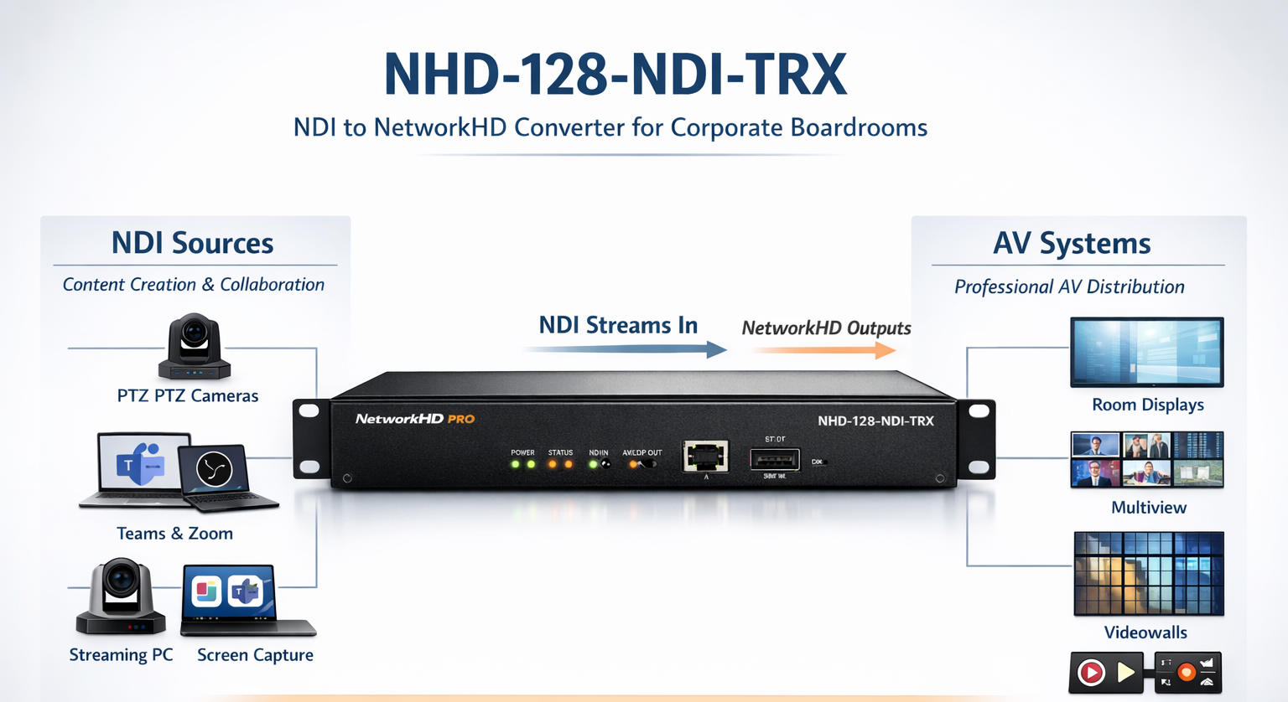
Vertical 3 (Corporate/Boardroom)
Problem:
Collaboration & Production Are Becoming IP-Based
NDI PTZ cameras
Teams / Zoom workflows
Software screen capture
Recording & streaming platforms
These systems generate NDI video streams on the network.
NDI sources cannot natively integrate into traditional AV distribution systems.
How TRX Helps:
8 NDI channels ingest into AVoIP
1 NHD to NDI return feed for production
Clean integration between control room and distribution
Powerful · Reliable · Simple

Slide 14
Benefits
1. True Bridge Device (Not Just Encode OR Decode)
Most competitors:
Encode only
Decode only
Limited channel count
WyreStorm:
8-channel NDI ingest
1-channel NHD to NDI
Bidirectional architecture
2. Channel Density Advantage
Competitors typically offer:
1 channel per box
4 channel at most (some models)
This unit:
8 channels in one chassis
Powerful · Reliable · Simple

Slide 15
Y.S.K
You should know:
Not seamless switching
Switching time 3~5 seconds
This is a conversion hub, not a production switcher
Do NOT position as:
A live production switcher
A seamless video processor
Position as:
Infrastructure bridge
System integrator tool
Powerful · Reliable · Simple

Slide 16
Questions?
Powerful · Reliable · Simple

